Slide 1
Fairness and Algorithmic Bias
Urban Analytics Summer School
2019

Slide 2

U.S. Legal definitions of discrimination
Disparate treatment is the illegal practice of treating an entity, such as a creditor or employer, differently based on a protected characteristic such as race, gender, age, religion, sexual orientation, or national origin.
Disparate impact is the result of systematic disparate treatment, where disproportionate adverse impact is observed on members of a protected class.
about intent
http://www.allenovery.com/publications/en-gb/Pages/Protected-characteristics-and-the-perception-reality-gap.aspx
about consequences
slide src: Julia Stoyanovich
Notes:
More formal definition; cite laws, 80% rule, statistical significance.

Slide 3

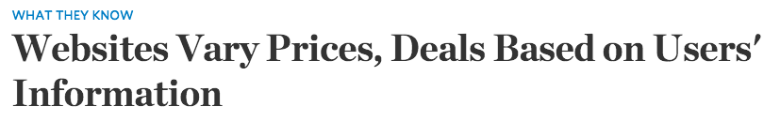
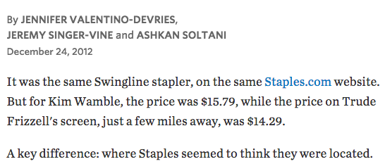
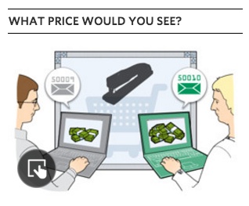
Ex: Staples online pricing
Reasoning: Offer deals to people that live near competitors’ stores
Effect: lower prices offered to buyers who live in more affluent neighborhoods
Notes:
From WLJ article:
A Wall Street Journal investigation found that the Staples Inc. website displays different prices to people after estimating their locations. More than that, Staples appeared to consider the person's distance from a rival brick-and-mortar store, either OfficeMax Inc. or Office Depot Inc. If rival stores were within 20 miles or so, Staples.com usually showed a discounted price.
In what appears to be an unintended side effect of Staples' pricing methods—likely a function of retail competition with its rivals—the Journal's testing also showed that areas that tended to see the discounted prices had a higher average income than areas that tended to see higher prices.

Slide 4
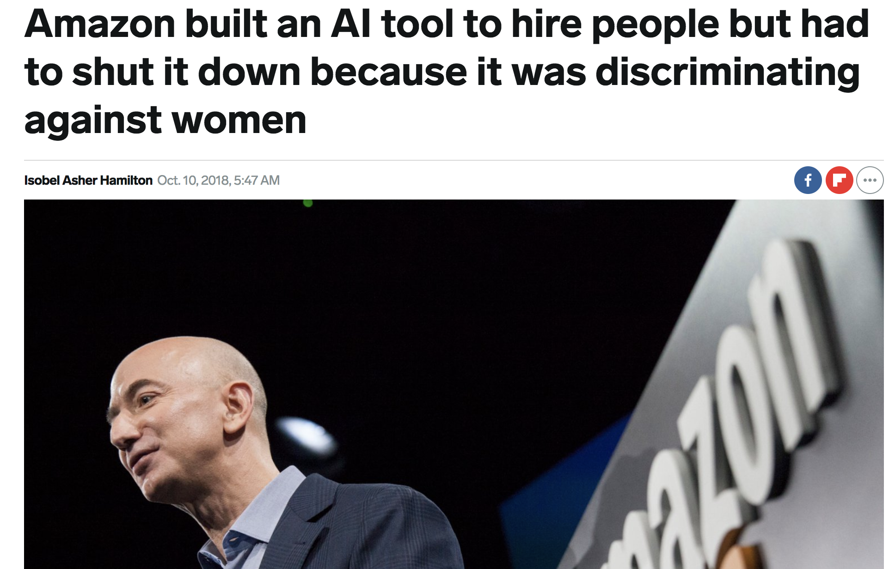

Slide 5
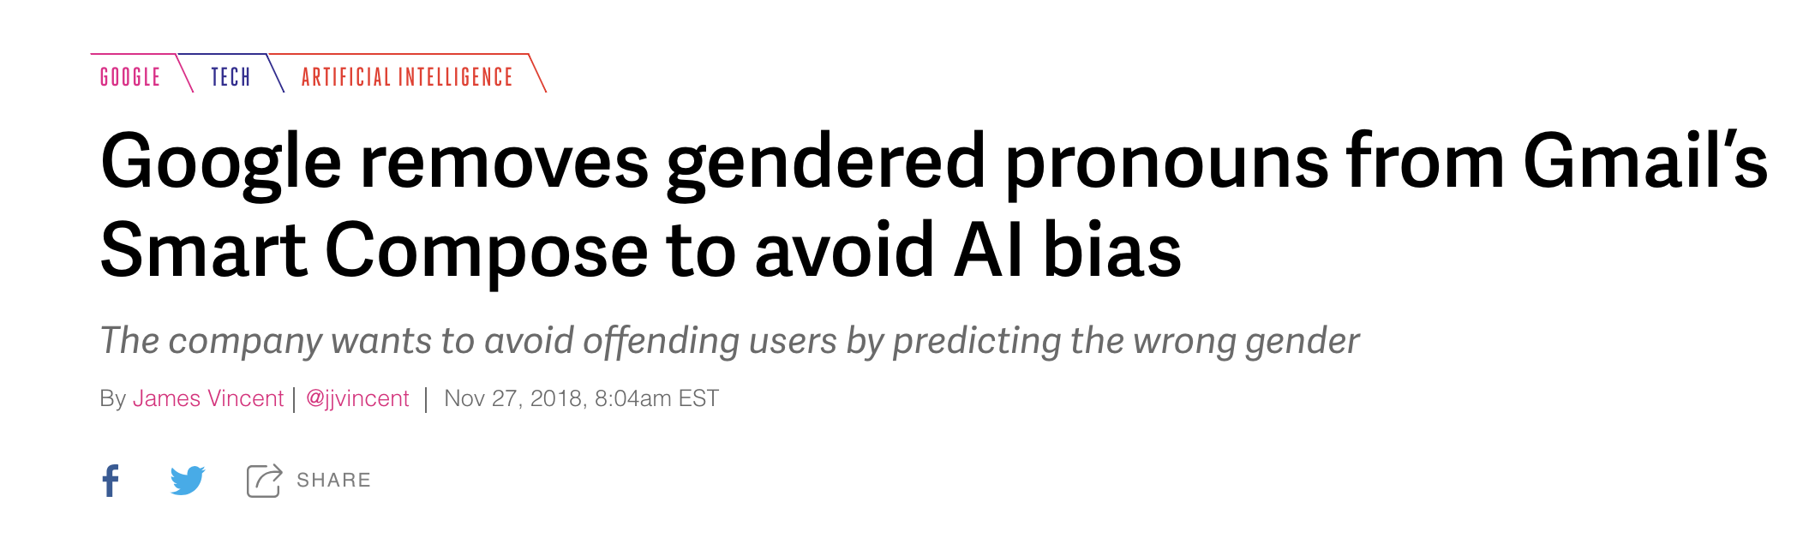

Slide 6
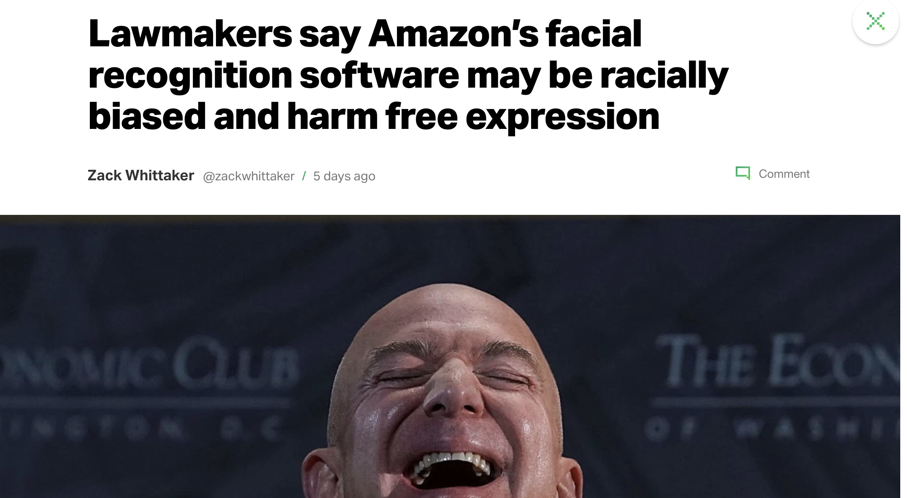

Slide 7
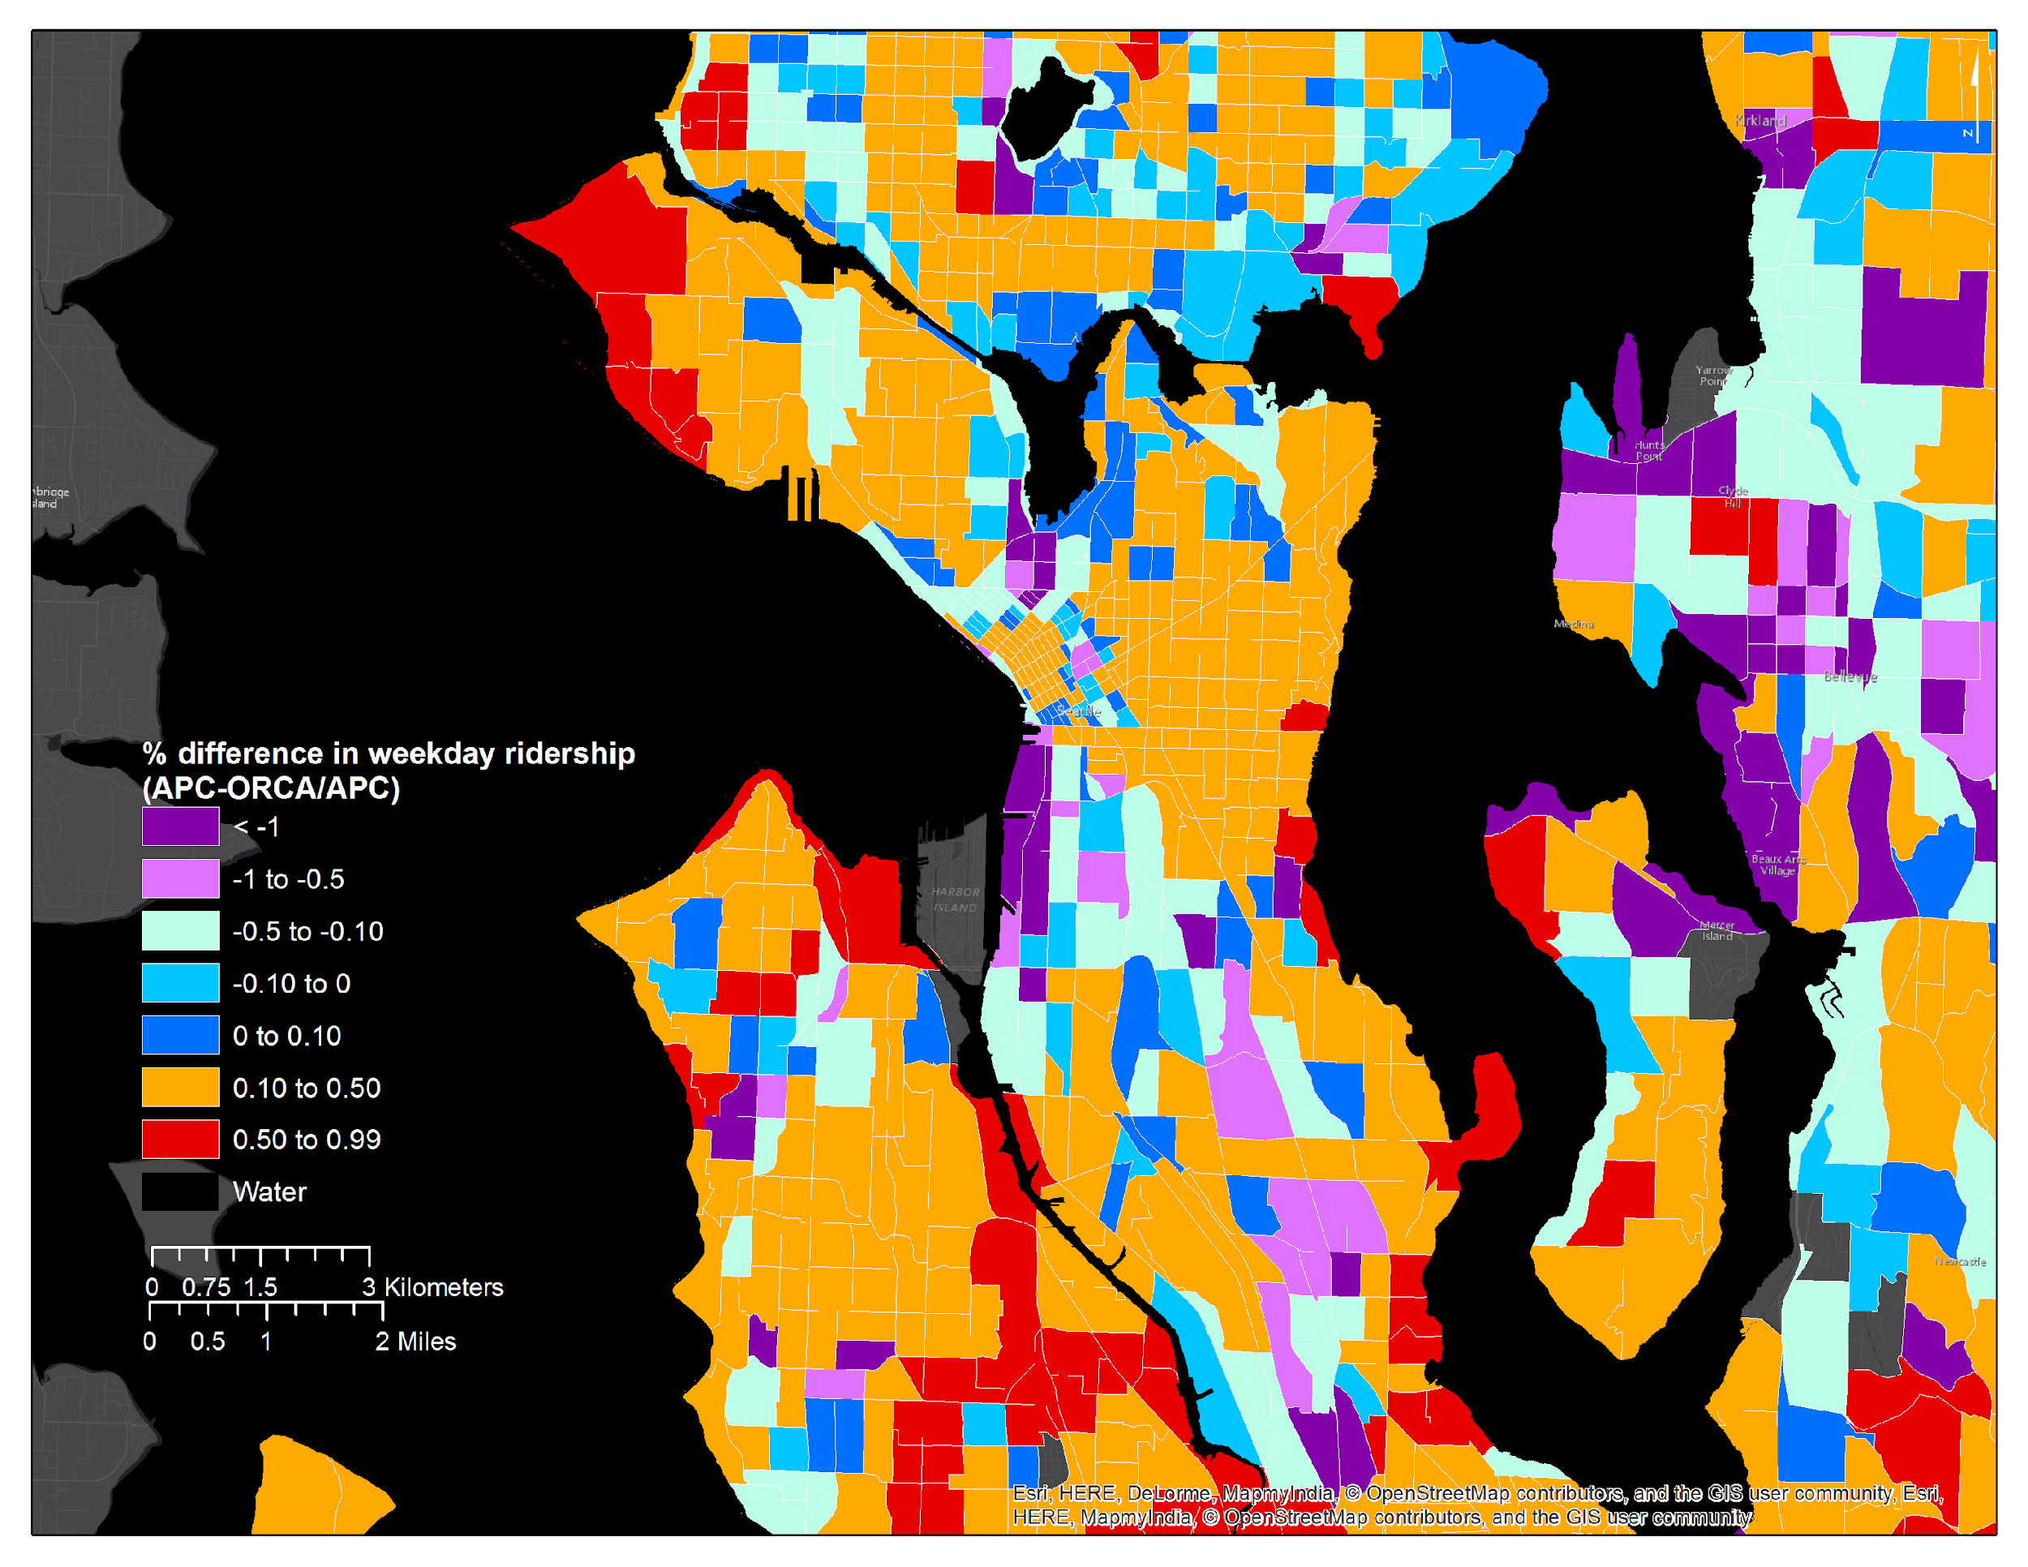

ORCA Percentage Difference in Ridership, Seattle
Mark Hallenbeck
TRAC

Slide 8
Google Translate swaps gender pronouns due to biased data
Notes:
Google’s language translation swaps pronouns for professions with historical gender bias

Slide 9
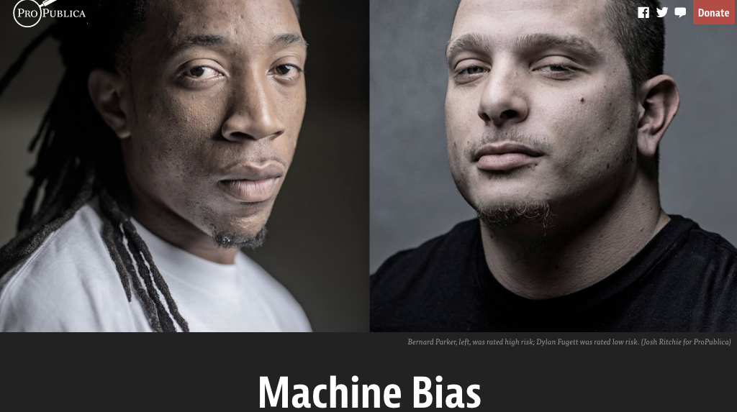
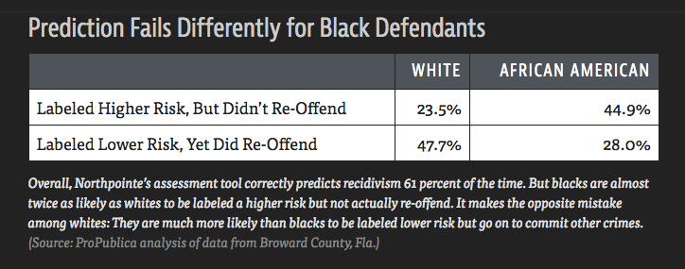
Propublica, May 2016

Slide 10
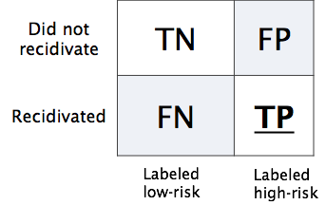
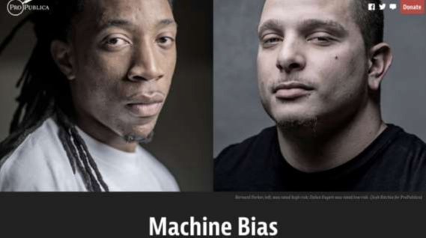
Propublica, May 2016
Predictive Parity: same positive outcome rates across groups, given predictions
Pr(high-risk | black, predicted low-risk) = Pr(high-risk | white, predicted low-risk)
Pr(high-risk | black, predicted high-risk) = Pr(high-risk | white, predicted high-risk)
Equalized Odds: same FP between groups
Pr(predicted high risk | black, low-risk) = Pr(predicted high-risk | white, low-risk)
These are mutually exclusive [Chouldechova 2017]
“21 different fairness metrics, implies hundreds of impossibility theorems”
[Narayanan 2018]
23
Notes:
the Equalized Odds and Predictive Parity are impossible to achieve simultaneously when prevalence of the two populations di ers, meaning Pr(Y = 1|S = 0) Pr(Y = 1|S = 1).

Slide 11
Algorithmic Fairness
ML algorithms influence decisions affecting people in tasks ranging from helping banks to determine the creditworthiness of customers to suggesting a likelihood that a criminal will reoffend
How can we ensure that our algorithms act in ways that do not reinforce systemic discrimination?
Notes:
Today, algorithms are harnessing volumes of macro- and micro-data to influence decisions affecting people in a range of tasks, from helping banks determine the creditworthiness of individuals, and in scoring how likely a criminal will commit another crime in the future, which influences the severity of sentencing.
How can we ensure that our algorithms act in ways that are fair or not biased? (as opposed to human)
There is no generally accepted definition of bias. But many existing definition tries to capture the following intuition
“bias”: a term that we define broadly as it relates to outcomes which are systematically less favorable to individuals within a particular group and where there is no relevant difference between groups that justifies such harms.

Slide 12

Problem setup (1): Outcomes
Consider a vendor assigning positive or negative
outcomes to individuals.
Positive Outcomes | Negative Outcomes
offered employment | denied employment
accepted to school | rejected from school
offered a loan | denied a loan
offered a discount | not offered a discount

Slide 13
Problem setup (2): Assigning outcomes to populations
Fairness is concerned with how outcomes are assigned to a population
positive outcomes
40% of the population
◦
◦
◦
◦
◦
◦
⊕
⊕
⊖
◦
◦
◦
⊖
◦
⊖
◦
◦
⊖
◦
◦
⊕
◦
◦
⊕
◦
◦
⊖
◦
◦
⊖
Population
Assignments
Individual with
negative outcome
Individual with
positive outcome

Slide 14
Sub-populations may be treated differently
Sub-population: those with red hair
(under the same assignment of outcomes)
positive
outcomes
40% of the whole population
hair color | red
 | not red
20%
of red
haired
disparate
impact
on red-haired
people
⊕
⊖
⊖
⊖
⊖
}
⊖
⊕
60%
of not red
haired
statistical
parity
fails
⊕
⊕
⊖
Notes:
Disparate impact in US is measured by comparing the rate of positive outcomes for the protected class (here 20%, assuming red-hairs are protected) divided by rate of positive outcomes for the population as a whole.
It that ratio is less than 80%, it is considered discriminatory (or potentially discriminatory).

Slide 15
One idea: Enforce statistical parity
Statistical parity (aka group fairness)
demographics of the individuals receiving any outcome are the same as demographics of the underlying population
positive
outcomes
40% of the whole population
hair color | red
 | not red
40%
of red
haired
⊕
⊖
⊖
⊖
⊕
⊖
⊖
40%
of not red
haired
⊕
⊕
⊖
US Law in many jurisdictions: 80% rule
The rate of positive outcomes for a protected group must be now less than 80% of the rate of positive outcomes for the majority group. (Not equal, but “close”)

Slide 16
Redundant encoding
Now consider the assignments under both
hair color (protected) and hair length (innocuous)
 |  | hair length
 |  | long | not long
hair color | red
 | not red
positive
outcomes
⊖
⊖
20%
of red
haired
⊕
⊖
⊖
60%
of not red
haired
⊕
⊕
⊖
⊕
⊖
Deniability
The vendor has adversely impacted red-haired people, but could claim that outcomes are assigned according to hair length.
Notes:
Because of redundant encoding, adverse impact to sub-population may be “deniable” or “unintended”

Slide 17
Blinding does not imply fairness
Removing hair color from the vendor’s assignment process does not prevent disparate impact
 |  | hair length
 |  | long | not long
hair color | red
 | not red
positive
outcomes
⊖
⊖
20%
of red
haired
⊕
⊖
⊖
60%
of not red
haired
⊕
⊕
⊖
⊕
⊖
Assessing disparate impact
Discrimination is assessed by the effect on the protected sub-population, not by the input or by the process that lead to the effect.
Notes:
The same example of redundant encoding shows why blinding does not imply fairness.

Slide 18
Redundant encoding
Let’s replace hair color with race (protected),
hair length with zip code (innocuous)
 |  | zip code
 |  | 10025 | 10027
race | black
 | white
positive
outcomes
⊖
⊖
20%
of black
⊕
⊖
⊖
60%
of white
⊕
⊕
⊖
⊕
⊖
Notes:
Redundant encoding was actually used to disguise discrimination: red lining

Slide 19
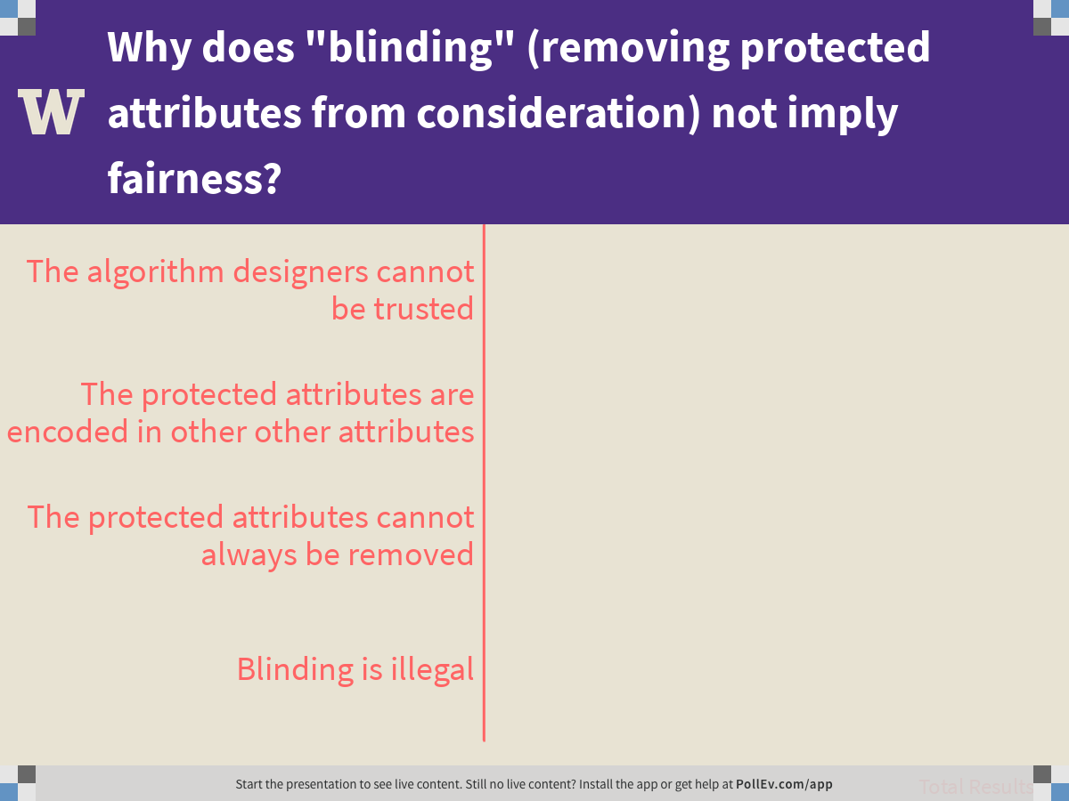
Notes:
Why does "blinding" (removing protected attributes from consideration) not imply fairness?
https://www.polleverywhere.com/multiple_choice_polls/7tEj79ppm35VaVefvuLVd

Slide 20
“Individual Fairness” vs. Group Fairness
Statistical parity (aka group fairness)
demographics of the individuals receiving any outcome are the same as demographics of the underlying population
 |  | credit score
 |  | good | bad
 | black
 | white
positive
outcomes
offered
credit
⊖
⊖
40%
of black
⊕
⊕
⊖
race
40%
of white
⊕
⊖
⊖
⊕
⊖
Individual fairness (Dwork)
any two individuals who are similar w.r.t. a particular task should receive similar outcomes.
But: Ignores the protected status of certain groups subject to institutionalized historical discrimination, which can influence *any* data collected about them.
Notes:
This is the example where stat. parity is imposed.
It leads to a decrease in utility for the vendor (because they are required to offer a positive outcome to a bad credit risk).
But it also hurts individual fairness: two individuals both with good credit, but one is denied a positive outcome.

Slide 21
Discrimination Criteria
[Indre Zliobaite, CoRR abs/1511.00148 (2015)]
Statistical tests check how likely the difference between groups is due to chance - is there discrimination?
Absolute measures express the absolute difference between groups, quantifying the magnitude of discrimination
Conditional measures express how much of the difference between groups cannot be explained by other attributes, also quantifying the magnitude of discrimination
Structural measures how wide-spread is discrimination? Think Simpson’s paradox, individual fairness.

Slide 22
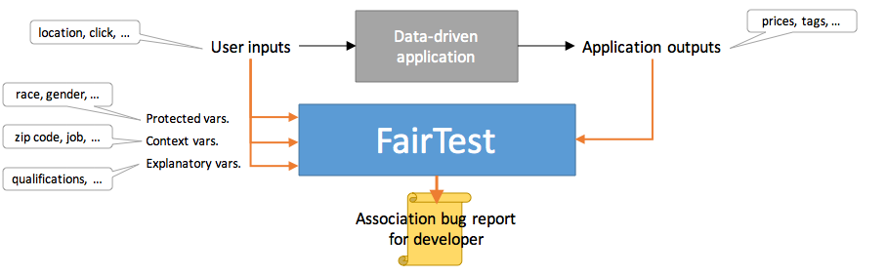
A systems approach: FairTest: fairness test suite for data analysis apps
[F. Tramèr et al., arXiv:1510.02377 (2015)]
Tests for unintentional discrimination according to several representative discrimination measures.
Automates search for context-specific associations between protected variables and application outputs
Report findings, ranked by association strength and affected population size

Slide 23
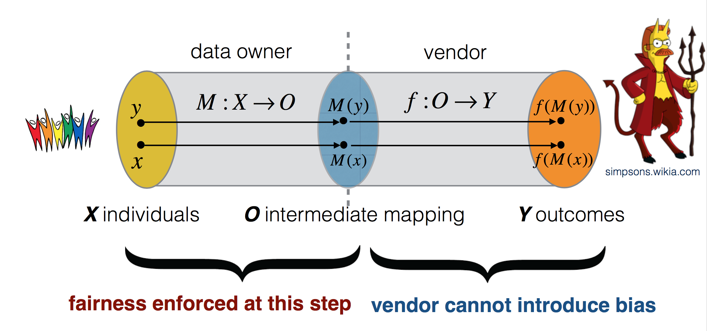
“Fairness through Awareness”
[C. Dwork, M. Hardt, T. Pitassi, O. Reingold, R. S. Zemel; ITCS 2012]

Slide 24
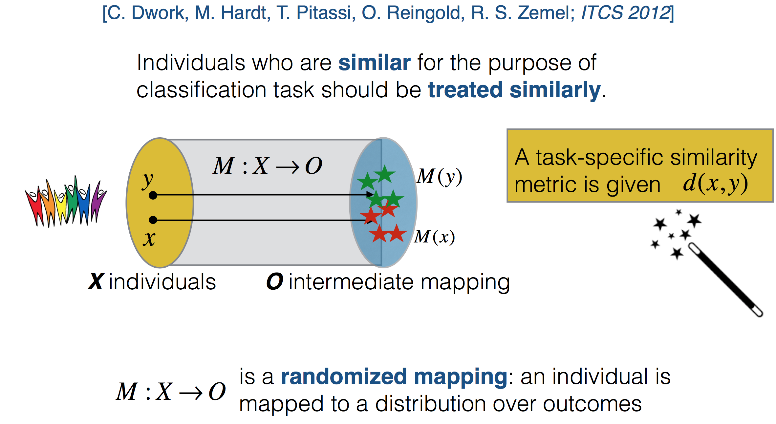
Task-specific Fairness

Slide 25
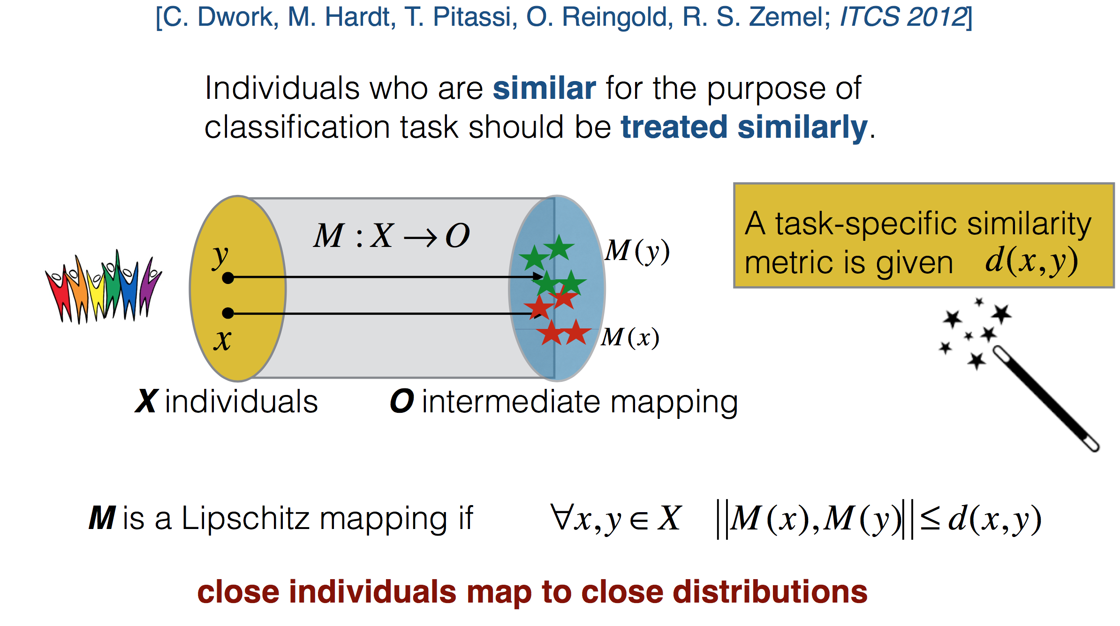
Fairness through a Lipschitz mapping

Slide 26
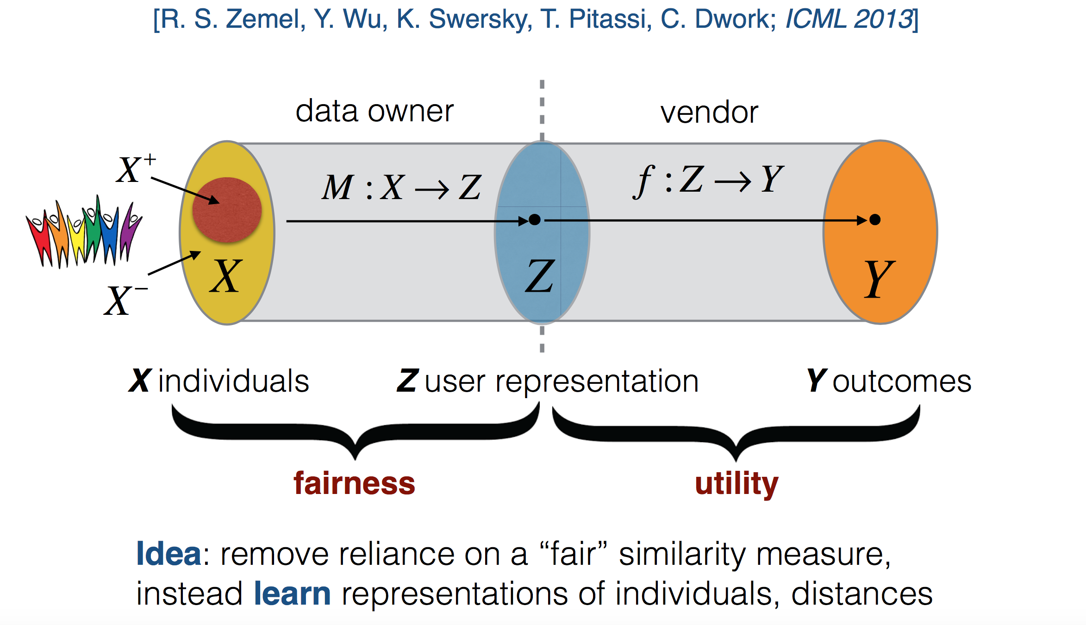
Learning Fair Representations

Slide 27
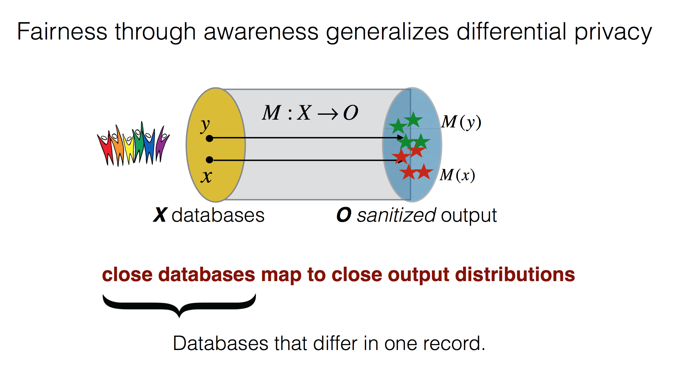
Connection to Privacy

Slide 28
RepairinG for BIAs, and causality-based methods

Slide 29
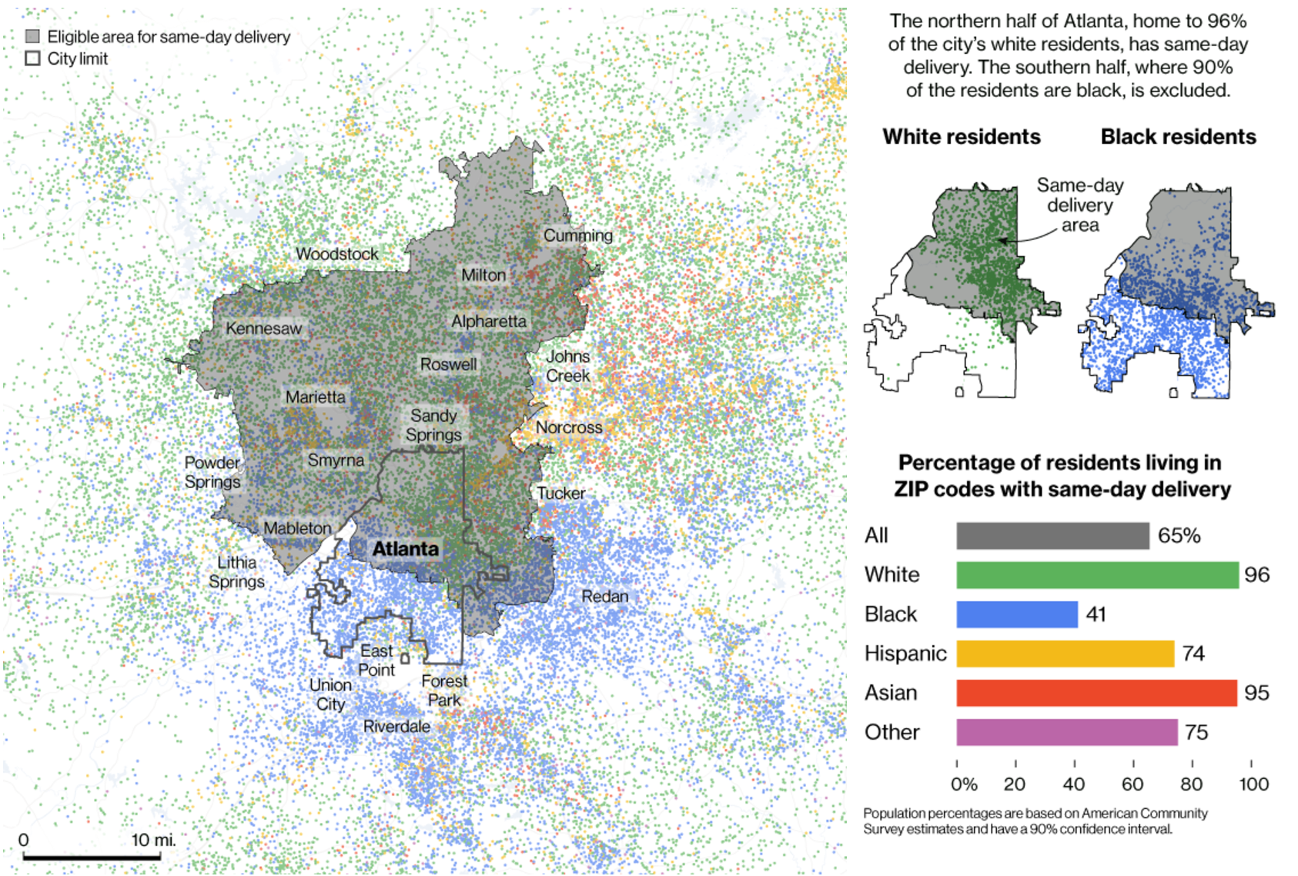
Amazon Prime Now Delivery Area: Atlanta
Bloomberg, 2016
Notes:
Let me give you an example.
Bloomberg wrote a piece in 2016 about the Amazon prime now delivery area. They trained a model to decide who to offer the service to, considering buying history, income, location. They did not consider race.
This is a map of Atlanta. I grew up in Atlanta. You can see that everyone in the north half received the discount and no one in the south half did. What else is true about the north half of Atlanta vs. the south half?

Slide 30
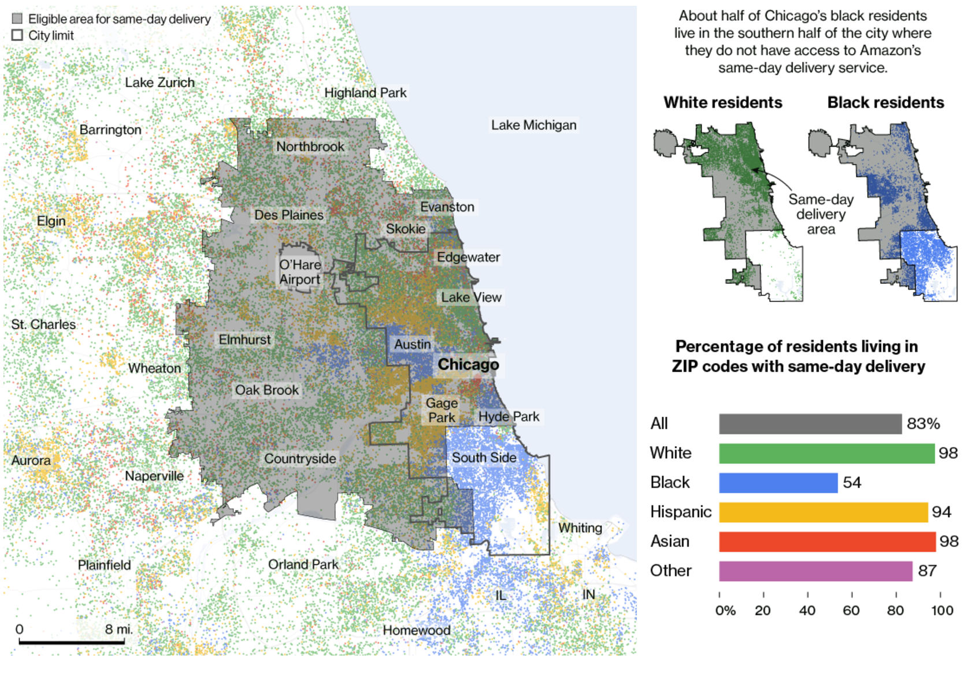
Amazon Prime Now Delivery Area: Chicago
Bloomberg, 2016
Notes:
It gets worse. In Chicago, everyone received the service except the south side, which is predominately African American.

Slide 31
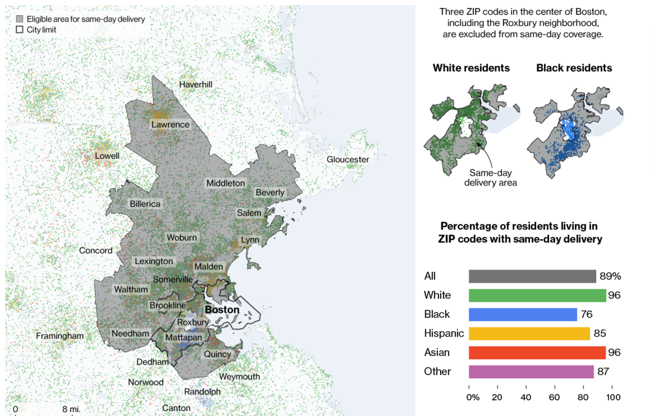
Amazon Prime Now Delivery Area: Boston
Bloomberg, 2016
Notes:
In Boston, they carved out a donut shape around Roxbury.
The HUD recently sued Facebook for this kind of digital redlining, and signaled that Twitter and Google are next.

Slide 32
redlining map of Atlanta, National Archives, 1938

Slide 33
Raw data considered harmful
Raw data is both an oxymoron and a bad idea; to the contrary, data should be cooked with care. Geoffrey Bowker (2005, p. 183-184)
Discount = f(buying history, zipcode) “We dropped race”
But zipcode = f(race), buying history = f(race)
So the raw data is misleading
Polluted by 300 years of institutionalized racism
We want data from the world we wish we had, not the world we do have
Consider the context and adjust the data prior to training models
Who has the authority to tell us what to adjust?
Data providers
Social scientists
How do we encode these adjustments?
Causality

Slide 34
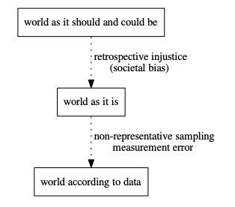
We need to understand the world we want wrt to the world we have if we want to correct for bias.
Implies incorporating a causal model
from “Prediction-Based Decisions and Fairness” by Mitchell, Potash and Barocas, 2018

Slide 35
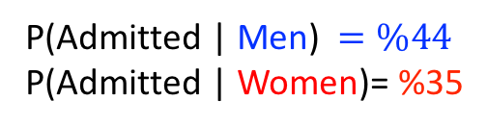
All the measures we discussed so far are associational
Associational: statistical relationships between outcomes and protected attributes
Associational measures are misleading
P(Admitted | Men) $=\%44$
P(Admitted | Women)= %35
[UC Berkeley 1973 grad school admissions]
Notes:
This seemingly paradoxical observation can be demystify using causal models that abstract the underling data generative process.
A BETTER tool to reason about fairness, is not associational fairness, but it is the causal model in the data.
Then explain the causal model here.
In the language of causal inference gender would indirectly effects admission result through the free will to choice different department.
An effect that that did not constitute evidence for
gender-based discrimination.

Slide 36
Associational Fairness: misleading
P(Admitted | Men) $=\%44$
P(Admitted | Women)= %35
Discrimination goes away when conditioned on department
[UC Berkeley 1973 grad school admissions]
Notes:
This seemingly paradoxical observation can be demystify using causal models that abstract the underling data generative process.
A BETTER tool to reason about fairness, is not associational fairness, but it is the causal model in the data.
Then explain the causal model here.
In the language of causal inference gender would indirectly effects admission result through the free will to choice different department.
An effect that that did not constitute evidence for
gender-based discrimination.

Slide 37
Simpson’s paradox
Notes:
Simpson’s paradox is pretty easy to handle, but all associational definitions of fairness can be subject to these statistical coincidences

Slide 38
Associational Fairness: misleading
Causal Model: Better
P(Admitted | Men) $=\%44$
P(Admitted | Women)= %35
G
D
A
Gender
Dept
Admitted
[UC Berkeley 1973 grad school admissions]
Notes:
This seemingly paradoxical observation can be demystify using causal models.
A causal diagram is a directed graph that displays causal relationships between attributes in a causalmodel. A causal diagram includes a set of variables (or nodes). Each node is connected by an arrow to one or more other nodes upon which it has a causal influence.
A BETTER tool to reason about fairness, is not associational fairness, but it is the causal model in the data.
In the language of causal inference gender would indirectly effects admission result through the free will to choice different department.
An effect that that did not constitute evidence for
gender-based discrimination.

Slide 39
Associational Fairness: misleading
Causal Model: Better
P(Admitted | Men) $=\%44$
P(Admitted | Women)= %35
G
D
A
Gender
Dept
Admitted
[UC Berkeley 1973 grad school admissions]
Notes:
This seemingly paradoxical observation can be demystify using causal models that use directed acyclic graph to abstract the
A BETTER tool to reason about fairness, is not associational fairness, but it is the causal model in the data.
Then explain the causal model here.
In the language of causal inference gender would indirectly effects admission result through the free will to choice different department.
An effect that that did not constitute evidence for
gender-based discrimination.

Slide 40
Associational Fairness definitions and Methods
Properties of data generative model (causal models)
Properties of the joint distribution (data)
 | Associational or Observational | Causal
In-processing (Modify the ML Algorithm) | Kamishima et al. (2012), Zafar et al. (2017b), Calders and Verwer (2010), Kilbertus et al. (2017), … | Russell et al. (2017), Kilbertus et al. (2017), Nabi and Shpitser (2018), …
Pre/post-processing (Modify the input/output Data) | Feldman et al. (2015), Hardt et al. (2016), Woodworth et al. (2017) Calmon et al. (2017), …
Capuchin
Notes:
The two main approaches to reduce or eliminate sources
of discrimination are summarized in Fig. 1. The most popular
is the in-processing, where the ML algorithm itself is
modified; this approach must be reimplemented for every
ML application. The alternative is to process either the training
data (pre-processing) or the output of the classifier itself
(post-processing). We advocate for the pre-processing strategy,
which is agnostic to the choice of ML algorithm and
instead interprets the problem as a database repair task.
Associational Causal
In-processing [5, 20, 21, 29, 48] [21, 29, 34]
(Modify the ML Algorithm)
Pre/post-processing [6, 13, 16, 45] Capuchin
(Modify the input/output Data) (this paper)

Slide 41
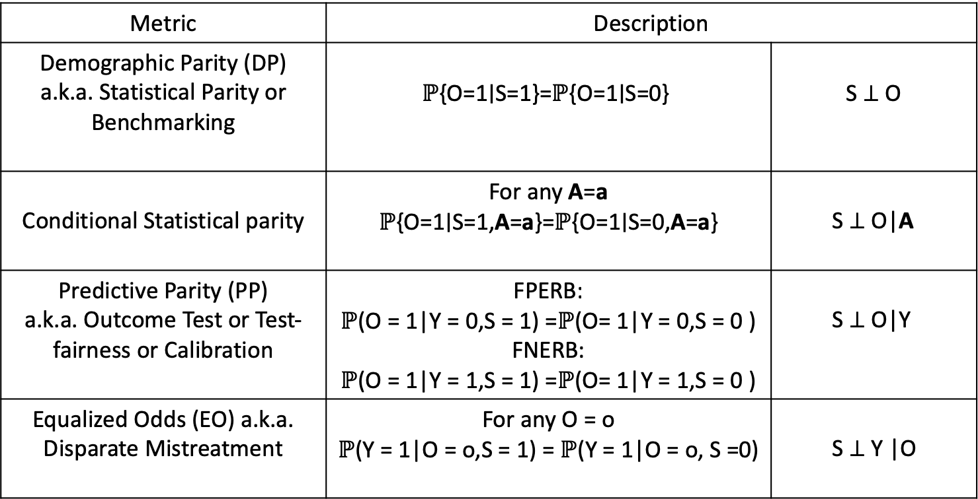
Observational Fairness Definitions
Metric | Description
Demographic Parity (DP) a.k.a. Statistical Parity or Benchmarking | $$\text{ℙ}\text{\{}\text{O}\text{=1∣}\text{S}\text{=1\}=}\text{ℙ}\text{\{}\text{O}\text{=1∣}\text{S}\text{=0\}}$$ | $$\text{S} \text{⊥} \text{O}$$
Conditional Statistical parity | For any A=a $$\text{ℙ}\text{\{}\text{O}\text{=1∣}\text{S}\text{=1,}\text{A}\text{=}\text{a}\text{\}=}\text{ℙ}\text{\{}\text{O}\text{=1∣}\text{S}\text{=0,}\text{A}\text{=}\text{a}\text{\}}$$ | S ⊥ O|A
Predictive Parity (PP) a.k.a. Outcome Test or Test-fairness or Calibration | FPERB: $\text{ℙ}$(O = 1|Y = 0,S = 1) =$\text{ℙ}$(O= 1|Y = 0,S = 0 ) FNERB: $\text{ℙ}$(O = 1|Y = 1,S = 1) =$\text{ℙ}$(O= 1|Y = 1,S = 0 ) | S ⊥ O|Y
Equalized Odds (EO) a.k.a. Disparate Mistreatment | For any O = o $\text{ℙ}$(Y = 1|O = o,S = 1) = $\text{ℙ}$(Y = 1|O = o, S =0) | S ⊥ Y |O
Notes:
During the past few years there has been an explosion of fairness definition and metric. It has been shown that some of this metrics are inconsistent.
Some people tends to believe that
These are associational or observational, i.e., they are property of the joint distribution of features, sensitive attribute and target outcome

Slide 42
Observational Fairness Definitions
Metric | Description
Demographic Parity (DP) a.k.a. Statistical Parity or Benchmarking | $$\text{ℙ}\text{\{}\text{O}\text{=1∣}\text{S}\text{=1\}=}\text{ℙ}\text{\{}\text{O}\text{=1∣}\text{S}\text{=0\}}$$ | $$\text{S} \text{⊥} \text{O}$$
Conditional Statistical parity | For any A=a $$\text{ℙ}\text{\{}\text{O}\text{=1∣}\text{S}\text{=1,}\text{A}\text{=}\text{a}\text{\}=}\text{ℙ}\text{\{}\text{O}\text{=1∣}\text{S}\text{=0,}\text{A}\text{=}\text{a}\text{\}}$$ | S ⊥ O|A
Predictive Parity (PP) a.k.a. Outcome Test or Test-fairness or Calibration | FPERB: $\text{ℙ}$(O = 1|Y = 0,S = 1) =$\text{ℙ}$(O= 1|Y = 0,S = 0 ) FNERB: $\text{ℙ}$(O = 1|Y = 1,S = 1) =$\text{ℙ}$(O= 1|Y = 1,S = 0 ) | S ⊥ O|Y
Equalized Odds (EO) a.k.a. Disparate Mistreatment | For any O = o $\text{ℙ}$(Y = 1|O = o,S = 1) = $\text{ℙ}$(Y = 1|O = o, S =0) | S ⊥ Y |O
S ⊥ O|Y
Impossibility Results
1 line proof!
S ⊥ Y
S ⊥ Y |O
Notes:
During the past few years there has been an explosion of fairness definition and metric. It has been shown that some of this metrics are inconsistent.
Some people tends to believe that
These are associational or observational, i.e., they are property of the joint distribution of features, sensitive attribute and target outcome

Slide 43
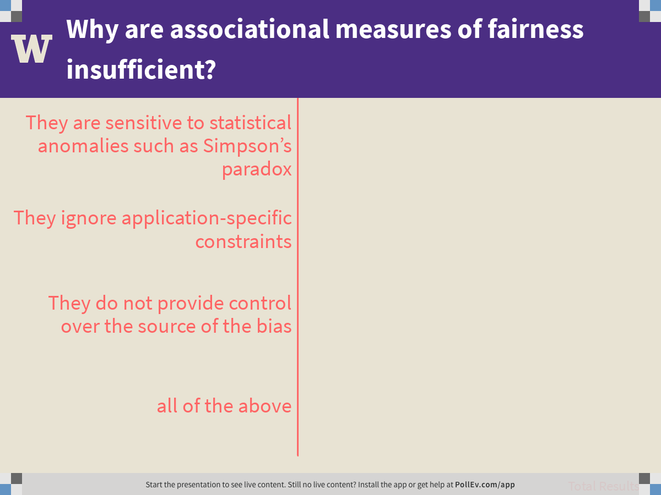
Notes:
Why are associational measures of fairness insufficient?
https://www.polleverywhere.com/multiple_choice_polls/qcmyPIE74NlFgZWP1BOXG

Slide 44
Causal Fairness
Hobbies
Qualification
Q
H
Q
G
D
A
Admitted
Gender
Dept
Notes:
Let’s create a toy example based on the Berkeley case. Suppose a collage has two department and in both of them admission decisions are made based on student’s qualification, hobby and gender!
According to that causal diagram with shows for instance, applicants gender affects their hobby bit not their qualification
Causal models for fairness have been considered in the literature. plan to spend 30' - 1 minute explaining what this means to the database person: "G, D, H,... are *attrbibutes* of the data, the data itself is not shown here. The problem of inferring the causal model from the data has been studied extensively, and it is hard and not always possible. I will assume for now that we have the causal model, later I will drop this assumption."

Slide 45
Causal Fairness
Hobbies
Qualification
Q
H
Q
G
D
A
Admitted
Gender
Dept
Fairness Definition (Attempt 1):
Arrange for no causal path from G to A
Notes:
The first approach is to forbid all causal paths from G to A. Too restrictive. This is the causal counterpart of prohibiting Statistical Parity! Which actually many ML methods does! This is too impractical.
To make it practical, we allow the user to classify variables into admissible and inadmissible. The former variables through which it is permissible for the protected
attribute to influence the outcome. In this example the user would label department as admissible since it is considered a fair use in admissions decisions, and would (implicitly) label all other variables as inadmissible, for example, hobby.

Slide 46
Causal Fairness
Hobbies
Qualification
Q
H
Q
G
D
A
Admitted
Gender
Dept
Fairness Definition (Attempt 1):
Arrange for no causal path from G to A
Problem: We cannot avoid:
G→D: applicants choose their department
D→A: departments make their own decisions
Notes:
This is exactly what happened in the Berkeley data

Slide 47
Causal Fairness
Hobbies
Qualification
Q
H
Q
G
D
A
Admitted
Gender
Dept
Our solution: partition variables into:
Admissible/ Inadmissible
Notes:
To capture such subtle situation, we partition the variable into admissible and inadvisable
Say that a key thing is the use of admissible variables. You can't have some magic fully general solution; the user needs to say what pathways between S and O they are willing to accept. (I like prior arrests as an example -- clearly influenced by racial profiling, but also clearly admissible)
``Fairness can not be reduced to a mathematical formula”

Slide 48
Causal Fairness
Hobbies
Qualification
Admissible
Q
H
Q
G
D
A
Admitted
Gender
Dept
Our solution: partition variables into:
Admissible/ Inadmissible

Slide 49
Causal Fairness
Hobbies
Qualification
Admissible
Q
H
Q
Inadmissible
G
D
A
Admitted
Gender
Dept
Our solution: partition variables into:
Admissible/ Inadmissible

Slide 50
Causal Fairness
Hobbies
Qualification
Admissible
Q
H
Q
Inadmissible
G
D
A
Admitted
Gender
Dept
Fairness Definition (Attempt 2):
There is no inadmissible causal path G to A
Notes:
This is exactly what happened in the Berkeley data
Note that this is just the idea behind our main definition. IN general causal DAGs are not available, we only have partial knowledge. We use intervention to define fairness in the presence of partial knowledge about the domain. Please see the paper for details.

Slide 51
Causal Fairness
Hobbies
Qualification
Admissible
Q
H
Q
Inadmissible
G
D
A
Admitted
Gender
Dept
Fairness Definition (Attempt 2):
There is no inadmissible causal path G to A
Problem: full causal models unavailable
Notes:
This is exactly what happened in the Berkeley data
Note that this is just the idea behind our main definition. IN general causal DAGs are not available, we only have partial knowledge. We use intervention to define fairness in the presence of partial knowledge about the domain. Please see the paper for details.

Slide 52
Causal Fairness
Hobbies
Qualification
Admissible
Q
H
Q
Inadmissible
G
D
A
Admitted
Gender
Dept
Fairness Definition (Final!):
Based on intervention (next slide)
Notes:
This is exactly what happened in the Berkeley data
Note that this is just the idea behind our main definition. IN general causal DAGs are not available, we only have partial knowledge. We use intervention to define fairness in the presence of partial knowledge about the domain. Please see the paper for details.

Slide 53
Aside: Interventions
D=GDHO
hobbies
H
G
D
O
gender
dept
admitted
Notes:
Topic 2.2: Bill
Sure, there are 21 definitions of fairness, and a family of impossibility theorems saying they can’t all be satisfied. So maybe we all wait and let the theory shake out before we bother with this stuff.
I’m going to make your life easier.
All these measures are just ratios that try to understand the relationship between some variable and some outcome.
So let’s take a step back. We have a dataset D = XZY. We want to understand the effect of X on Y. Why not just measure the correlation? If you see a correlation between race and recidivism, is that evidence that race causes recidivism? No, because there may be confounding variables. If arrests are concentrated in particular zipcodes, and those zipcodes have different demographics than the overall population, then there’s an alternative explanation.
We want to understand the causal effect of race on recidivism, just like we want to understand the causal effect of airline on delays.
Causal effect means the conditional mutual information. Fairness, then, is when the conditional mutual information is zero. But better yet, you can use all the inference mechanisms of causality to not just measure fairness, but to reason about algorithms for what to do about it. Ses Babak Salimi’s paper in SIGMOD this year, and see a paper in BiDU workshop this Friday on transportation data.
One caveat: the law is disparate impact, specifically the ratio of accuracy between protected group and dominant group. But the point is that you don’t want to just measure fairness, you want to do something about it. And you can’t reason about the causes without causality.

Slide 54
Aside: Interventions
D=GDHO
hobbies
H
G
D
O
gender
dept
admitted
[Pearl, 2009]
Notes:
Topic 2.2: Bill
Pr(V) = \prod_{X\in V} Pr(X | Parents(X))
\text{Pr}(o|D=\text{cs})= \sum_{g,h} \text{Pr}(g) \text{Pr}(h|g) \text{Pr}(D=\text{cs}|g,h) \text{Pr}(o|D=\text{cs},h)
Sure, there are 21 definitions of fairness, and a family of impossibility theorems saying they can’t all be satisfied. So maybe we all wait and let the theory shake out before we bother with this stuff.
I’m going to make your life easier.
All these measures are just ratios that try to understand the relationship between some variable and some outcome.
So let’s take a step back. We have a dataset D = XZY. We want to understand the effect of X on Y. Why not just measure the correlation? If you see a correlation between race and recidivism, is that evidence that race causes recidivism? No, because there may be confounding variables. If arrests are concentrated in particular zipcodes, and those zipcodes have different demographics than the overall population, then there’s an alternative explanation.
We want to understand the causal effect of race on recidivism, just like we want to understand the causal effect of airline on delays.
Causal effect means the conditional mutual information. Fairness, then, is when the conditional mutual information is zero. But better yet, you can use all the inference mechanisms of causality to not just measure fairness, but to reason about algorithms for what to do about it. Ses Babak Salimi’s paper in SIGMOD this year, and see a paper in BiDU workshop this Friday on transportation data.
One caveat: the law is disparate impact, specifically the ratio of accuracy between protected group and dominant group. But the point is that you don’t want to just measure fairness, you want to do something about it. And you can’t reason about the causes without causality.

Slide 55
Aside: Interventions
D=GDHO
hobbies
H
do(D=“cs”)
G
D
O
gender
dept
admitted
[Pearl, 2009]
Notes:
Topic 2.2: Bill
Pr(V) = \prod_{X\in V} Pr(X | Parents(X))
\text{Pr}(o|D=\text{cs})= \sum_{g,h} \text{Pr}(g) \text{Pr}(h|g) \text{Pr}(D=\text{cs}|g,h) \text{Pr}(o|D=\text{cs},h)
Sure, there are 21 definitions of fairness, and a family of impossibility theorems saying they can’t all be satisfied. So maybe we all wait and let the theory shake out before we bother with this stuff.
I’m going to make your life easier.
All these measures are just ratios that try to understand the relationship between some variable and some outcome.
So let’s take a step back. We have a dataset D = XZY. We want to understand the effect of X on Y. Why not just measure the correlation? If you see a correlation between race and recidivism, is that evidence that race causes recidivism? No, because there may be confounding variables. If arrests are concentrated in particular zipcodes, and those zipcodes have different demographics than the overall population, then there’s an alternative explanation.
We want to understand the causal effect of race on recidivism, just like we want to understand the causal effect of airline on delays.
Causal effect means the conditional mutual information. Fairness, then, is when the conditional mutual information is zero. But better yet, you can use all the inference mechanisms of causality to not just measure fairness, but to reason about algorithms for what to do about it. Ses Babak Salimi’s paper in SIGMOD this year, and see a paper in BiDU workshop this Friday on transportation data.
One caveat: the law is disparate impact, specifically the ratio of accuracy between protected group and dominant group. But the point is that you don’t want to just measure fairness, you want to do something about it. And you can’t reason about the causes without causality.

Slide 56
Causally Fair Prediction
Hobbies
Qualification
Admissible
Q
H
Q
Inadmissible
G
D
A
Admitted
Gender
Dept
This talk: Fairness Definition (Attempt 2):
There is no inadmissible causal path G to A
Notes:
Suppose we want to build an ML model using historical data D collected from this collage

Slide 57
Interventional K-Fairness
Babak Salimi
Luke Rodriguez
User specifies a set of admissible variables K
Don’t want to remove all effects of protected attribute, but want to be deliberate about which effects are allowed
An application is fair if the protected attribute does not affect the outcome for any possible configuration of (any superset of) admissible variables.
Ex: The admissions case does not satisfy interventional {D}-fairness
Salimi et al, SIGMOD 2019, best paper

Slide 58
Problem: We don’t actually have a causal graph
Babak Salimi
Theorem: An application is interventionally K-fair if the Markov boundary of the outcome is a subset of the admissible variables
V is a Markov blanket of X iff
think nodes that “shield” X from the rest of the variables
MB(X) = parents(X) U children(X) U parents(children(X))
V is the Markov boundary of X if V is the minimal markov blanket
Key idea: Given the admissible variables K, we can derive a set of conditional independence constraints (CIs) that imply interventional K-fairness.
Then: Relate these CIs to database repair problems

Slide 59
Causally Fair Prediction
Hobbies
Qualification
Admissible
Q
H
Q
Inadmissible
G
D
A
Admitted
Gender
Dept
This talk: Fairness Definition (Attempt 2):
There is no inadmissible causal path G to A
Can we still build a causally fair ML algorithm using historical data D collected from this situation?
Notes:
Say that the historical data is biased, so whatever you train, will inherit this bias.

Slide 60
Causally Fair Prediction
Hobbies
Qualification
Admissible
Q
H
Q
Inadmissible
G
D
A
Admitted
Gender
Dept
This talk: Fairness Definition (Attempt 2):
There is no inadmissible causal paths G to A
Attempt 1: Drop G and H from data and model!
Train ML using only Q and D. PROBLEM….
Notes:
Yes, just use admissible variables. Then since classifier is just a deterministic function of admissible variable the classifier becomes causal fair.

Slide 61
Causally Fair Prediction
Hobbies
Qualification
Admissible
Q
H
Q
Inadmissible
G
D
A
Admitted
Gender
Dept
Attempt 1: Drop G and H from data and model
Can not be used in data release situations, where all variables must be included
H is still predictive, it just needs to be fair (we want to tradeoff utility/fairness)
Notes:
Yes, just use admissible variables. Then since classifier is just a deterministic function of admissible variable the classifier becomes causal fair.

Slide 62
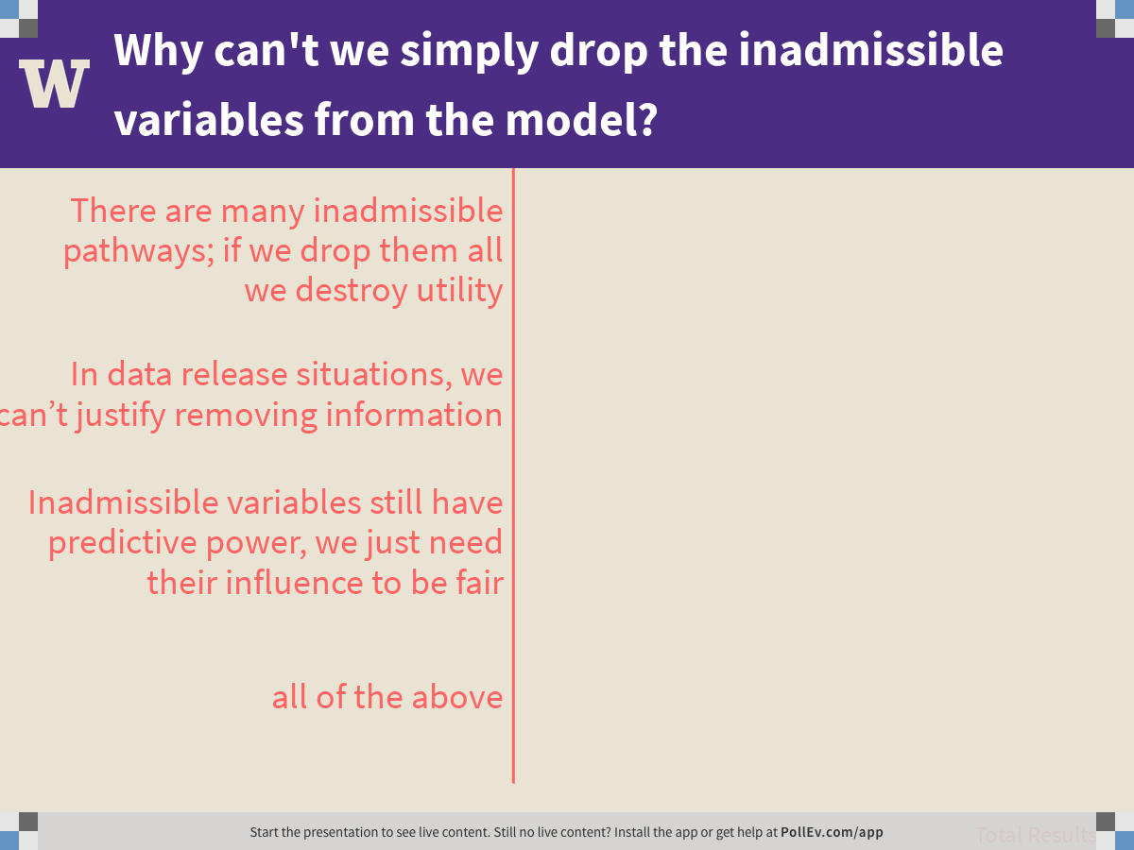
Notes:
Why can't we simply drop the inadmissible variables from the model?
https://www.polleverywhere.com/multiple_choice_polls/hwcZLez8IDb8BAGbTwI3z

Slide 63
Causally Fair Prediction
Hobbies
Qualification
Admissible
Q
H
Q
Inadmissible
G
D
A
Admitted
Gender
Dept
This talk: Fairness Definition (Attempt 2):
There is no inadmissible causal path G to A
Our solution: repair D to a data D’ that we wish we had!
Notes:
Can we instead adjust the data to account for the underling discrimination

Slide 64
Causally Fair Prediction
Hobbies
Qualification
Admissible
Q
H
Q
Inadmissible
G
D
A
Admitted
Gender
Dept
This talk: Fairness Definition (Attempt 2):
There is no inadmissible causal path G to A
Our solution: repair D to a data D’ that we wish we had!
Notes:
Can we instead adjust the data to account for the underling discrimination

Slide 65
Causally Fair Prediction
Hobbies
Qualification
Admissible
Q
H
Q
The data D’ we want,
has this causal model
Inadmissible
G
D
A
Admitted
Gender
Dept
This talk: Fairness Definition (Attempt 2):
There is no inadmissible causal path G to A
Our solution: repair D to a data D’ that we wish we had!
Notes:
Can we instead adjust the data to account for the underling discrimination

Slide 66
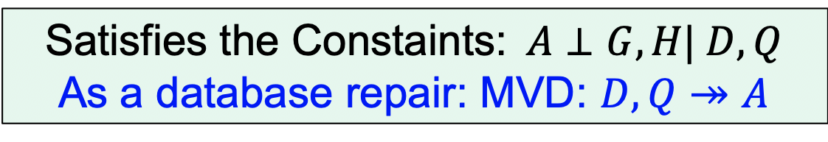
Causally Fair Prediction
Hobbies
Qualification
Admissible
Q
H
Q
The data D’ we want,
has this causal model
Inadmissible
G
D
A
Admitted
Gender
Dept
Our solution: repair D to a data D’ that we wish we had!
Satisfies the Constaints:$A⊥G,H\text{|} D,Q$
As a database repair: MVD: $D,Q↠$ $A$
Notes:
Can we instead adjust the data to account for the underling discrimination

Slide 67
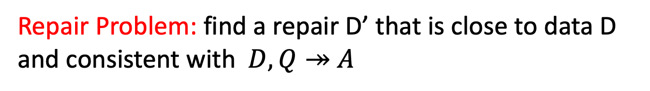
Causally Fair Prediction
Hobbies
Qualification
Admissible
Q
H
Q
Inadmissible
G
D
A
Admitted
Gender
Dept
Repair Problem: find a repair D’ that is close to data D and consistent with$D,Q↠$ $A$
Notes:
Can we instead adjust the data to account for the underling discrimination

Slide 68
Causally Fair Prediction
Hobbies
Qualification
Admissible
Q
H
Q
Inadmissible
G
D
A
Admitted
Gender
Dept
Repair Problem: find a repair D’ that is close to data D and consistent with$D,Q↠$ $A$
[MaxSAT and Low Rank Matrix Factorization]
Notes:
Can we instead adjust the data to account for the underling discrimination

Slide 69
Causally Fair Prediction
Hobbies
Qualification
Admissible
Q
H
Q
Inadmissible
G
D
A
Admitted
Gender
Dept
Repair Problem: find a repair D’ that is close to data D and consistent with$D,Q↠$ $A$
Theorem: any classifier trained using the repair D’ is causally fair even on unseen test data (under mild assumptions)
Notes:
Can we instead adjust the data to account for the underling discrimination

Slide 70
Experiment
[UCI Adult Census dataset ]
Source: Census bureau
Task: Discover high revenue people from census data. Two-class
Features: 14 attributes including age, occupation, education, marital status
Size: 48k rows
Repair Task: direct and indirect effect of Gender on Income via Marital Status
Details: Bias and accuracy measured using 5-fold cross validation (we ONLY repaired training data)
Notes:
The “adult” dataset from the UCI repository has records demographic information such as level of education and job related variables
job related variables occupation.
The objective is to learn a statistical model that predicts the class of income for a given individual. Suppose banks are interested in using this model to identify reliable candidates for loan application. Raw use of data might construct models that are biased towards females who are perceived to have lower income in general compared to males.
We used CAPUCHIN to remove the mentioned sources of discrimination from Adult
data.
Then, we trained the classifiers on both original and repaired training datasets using
the set of variables A [ N [ S.

Slide 71
Capuchin vs. Others
yellow is good, dark is bad
[Fledman et. al. SIGKDD 2015]
[Calmon et. al., NIPS 2017]
Causal Bias
Statistical Parity
False Positive Balance
True Negative Balance
Notes:
CAPUCHIN reduced DP and other associational metrics
as a side effect. However, CAPUCHIN outperformed both methods in terms of utility

Slide 72
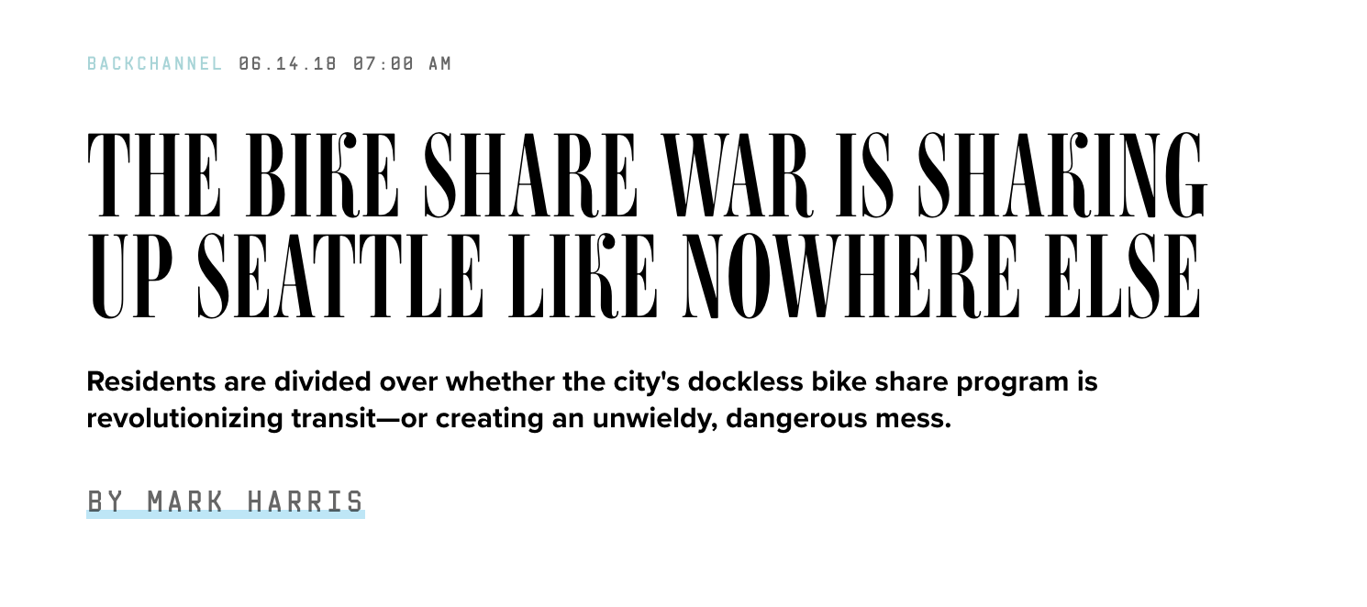
Example: Transportation Data
Example: Bike Share data
Babak Salimi
Luke Rodriguez

Slide 73
Example: Company -> Gender
Origin | Destination | Company | Gender
U District | U District | Bikes Inc. | Female
U District | U District | Bikes Inc. | Male
U District | U District | RideCorp | Female
U District | U District | RideCorp | Male
U District | Capitol Hill | Bikes Inc. | Female
Capitol Hill | U District | RideCorp | Female
Capitol Hill | U District | RideCorp | Male
38
43
47
39
15
13
7
…
Notes:
Running example – aggregated trips.
Change neighborhoods to Seattle neighborhood
This way we could see the bars getting closer in the length once we mitigate

Slide 74
Causal repairs useful for more than just fairness!
We can adjust for unwanted biases wrt a causal model
Consider a company RideCorp that advertises to men, introducing a bias Company -> Gender
This bias introduces error in mobility analysis applications
Origin | Destination | Company | Gender
U District | U District | Bikes Inc. | Female
U District | U District | Bikes Inc. | Male
U District | U District | RideCorp | Female
U District | U District | RideCorp | Male
U District | Capitol Hill | Bikes Inc. | Female
Capitol Hill | U District | RideCorp | Female
Capitol Hill | U District | RideCorp | Male
38
43
47
120
15
13
35
…
Notes:
Running example – aggregated trips.
Julia – it would help visually to replace the count column with a bar that shows the magnitude of the count – round to a 10 and round it
Change neighborhoods to Seattle neighborhood
This way we could see the bars getting closer in the length once we mitigate

Slide 75
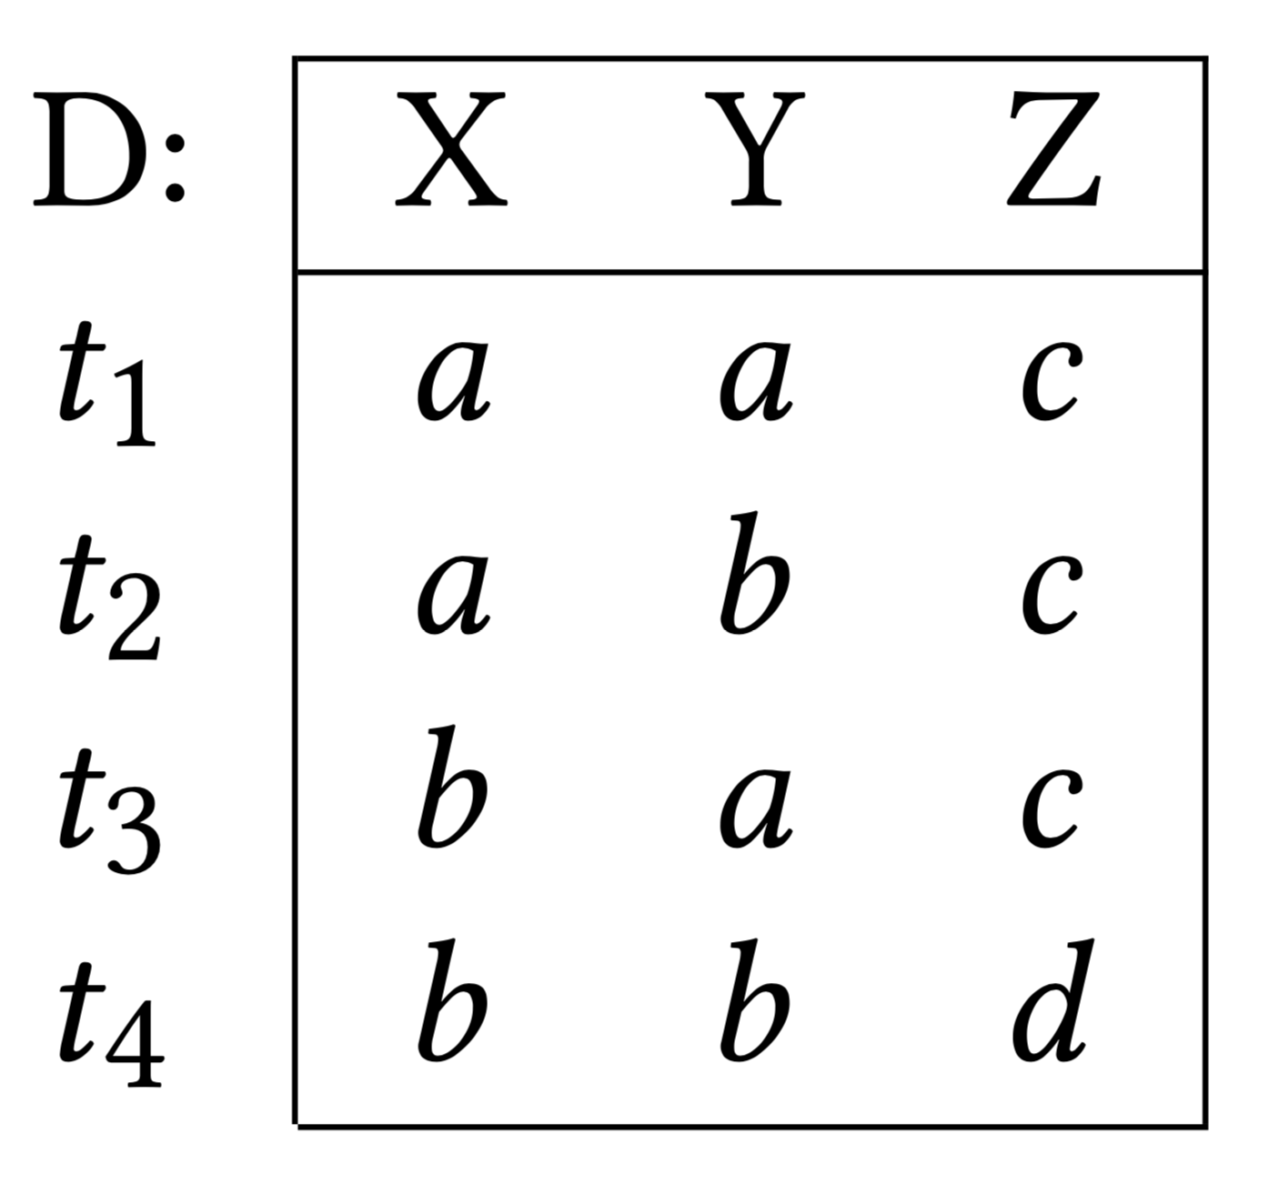
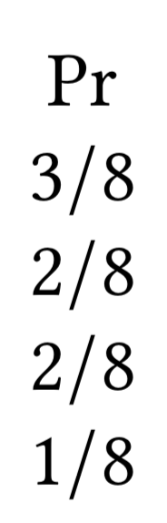
Given conditional independence constraints, derive
DB-style multi-valued dependencies (MVDs)
Does D satisfy
?
Delete a tuple
Insert a tuple
Consider probabilities to find a minimal repair

Slide 76
Example: Company and Gender
Origin | Destination | Company | Gender
U District | U District | Bikes Inc. | Female
U District | U District | Bikes Inc. | Male
U District | U District | RideCorp | Female
U District | U District | RideCorp | Male
U District | Capitol Hill | Bikes Inc. | Female
Capitol Hill | U District | RideCorp | Female
Capitol Hill | U District | RideCorp | Male
38
43
59
62
16
20
23
…
Notes:
Running example – aggregated trips.
Julia – it would help visually to replace the count column with a bar that shows the magnitude of the count – round to a 10 and round it
Change neighborhoods to Seattle neighborhood
This way we could see the bars getting closer in the length once we mitigate

Slide 77
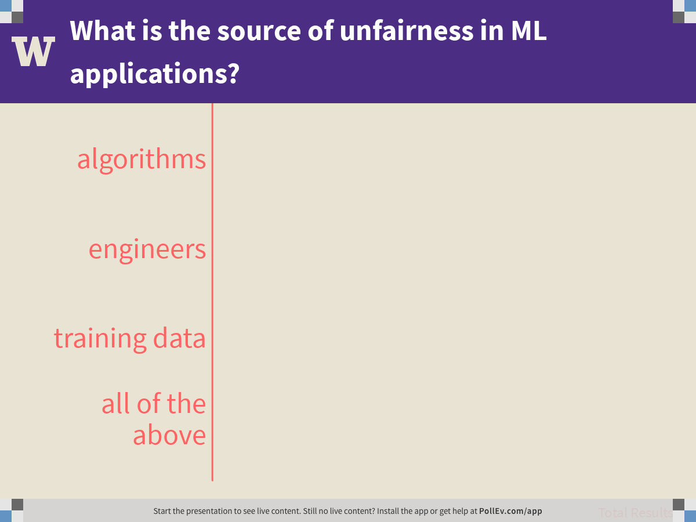
Notes:
What is the source of unfairness in ML applications?
https://www.polleverywhere.com/multiple_choice_polls/FBrkYwoY94GAhJJkt1gsj

